Slide 1

Teams and GitHub
David Metzger
Anshika Goyal
Daniel Kim

Slide 2
Agenda
Topic | Speaker | Duration
Welcome and Introduction | David Metzger Anshika Goyal Daniel Kim | 5 min
How to collaborate using Microsoft Teams | David Metzger Anshika Goyal | 15 min
How to use GitHub | Daniel Kim | 10 min
How to get access to Lab Environment | Daniel Kim | 20 min
Recap and Questions | All | 10 min

Slide 3




Hack4EquityGA is Brought to You By
Role: Experienced in Hackathon development, Accenture brings strategic organization, structure and focus to broad team goals. Accenture is a Global Fortune 500 company committed to driving change.
Role: Healthy Mothers, Healthy Babies Coalition of Georgia improves access to prenatal and preventive healthcare for thousands of women, children and families in Georgia through direct service, collaborative advocacy and community education. They bring extensive local context.
Role: Microsoft is a technology company that produces software and computers. They are building the "sandbox" for creation and guide technology development.
Role: Conceived the Hack4Health and bringing expert scientific knowledge to bear on Black maternal health equity. Additionally, J&J has significant collaborations in Georgia evidenced by relationships with both academic and community organizations.

Slide 4
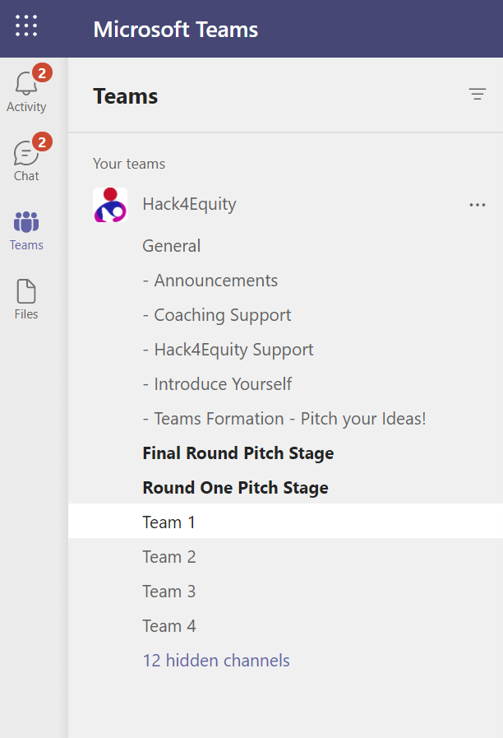
Mastering the Teams Channels
Make sure you have been added to the Hack4Equity Team on Microsoft Teams
Announcements - check here regularly for important updates related to the event.
Coaching Support - Connect to coaches for technical questions
H4E Support - Post any questions you have about the event or general inquiries.
Introduce Yourself - Take a minute to introduce yourself (background and skillsets, etc) and share a fun fact about yourself!
Team Formation - Post a summary of your idea and/or skills to look for members or join a team.
Teams - Join one of the channels corresponding to your Team number.
Main Stage for Tracks - Join one of the channels corresponding to your track.

Slide 5
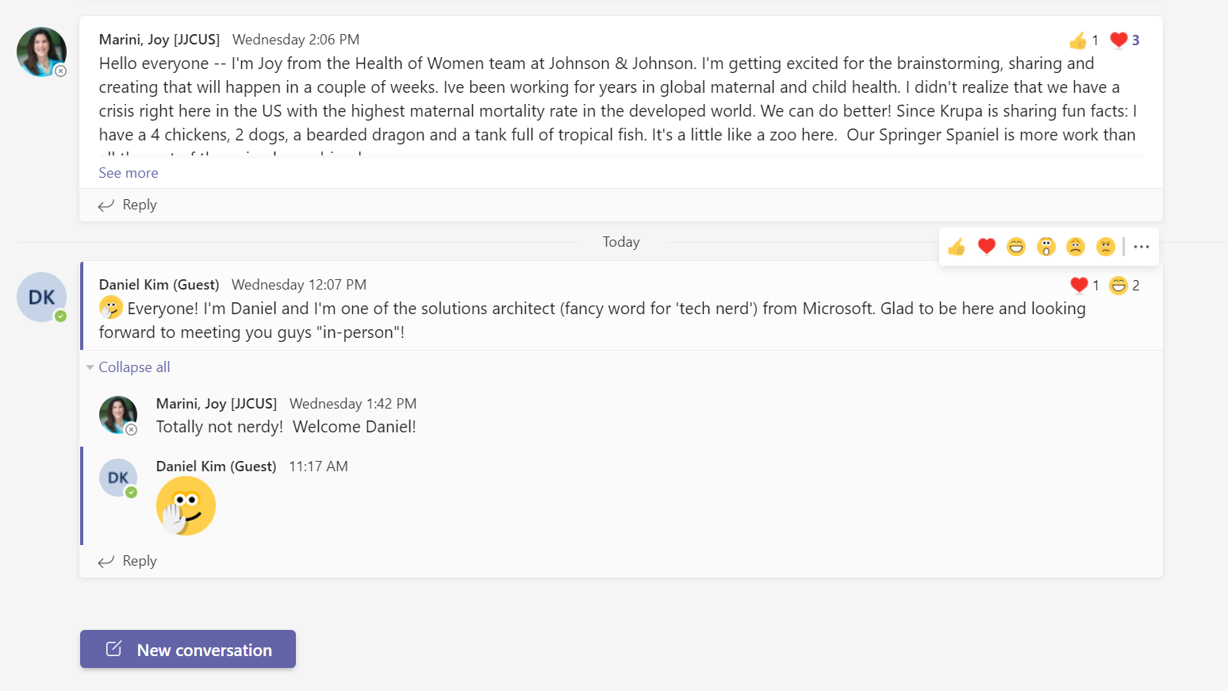
How to interact
Threads
Show some love
Reply to thread
Start a new conversation thread

Slide 6
START or JOIN a channel meeting

Slide 7
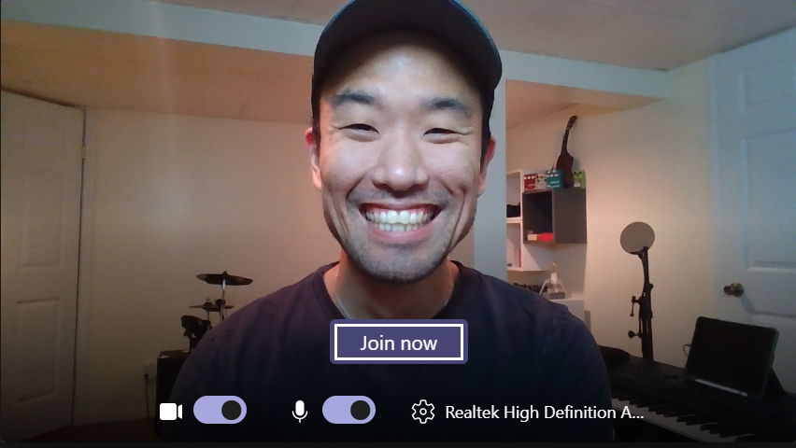

SMILE
Camera On/Off – For a more collaborative experience we encourage everyone to turn on their cameras. Especially when hacking with your team
Mic On/Off – Make sure to check if your mic is on or not. We all

Slide 8

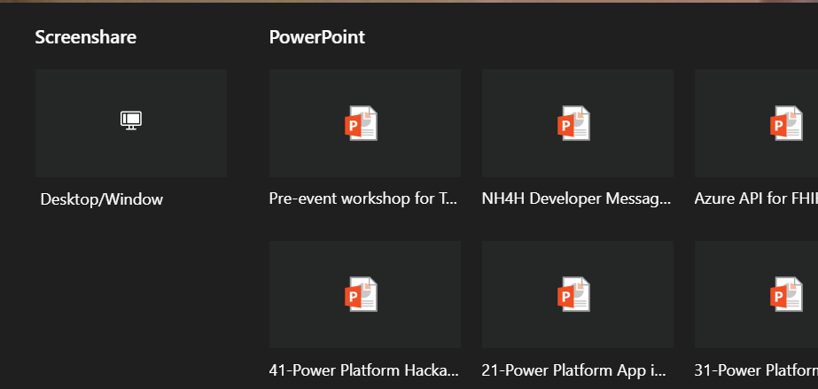
MORE ICONS
*Share Screen* – During your team sessions or during the judging sessions you will need to share your screen to present so make sure you are familiar with this function!
*CHAT* – Use this icon to post your thoughts and also read other’s messages.
Camera/Mic – Same functionality as previously mentioned
Raise Hand – Since it’s a virtual meeting this is a good way to let others you have something to say!

Slide 9
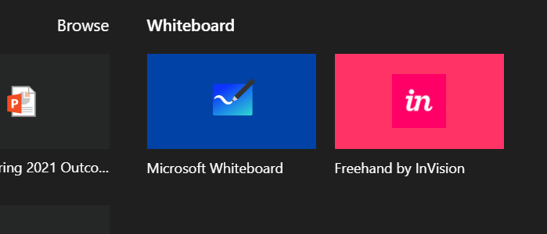
WHITEBOARD Design sessions you can share with others in real time
*Share Screen*
Click this button to see the
Whiteboard option to the right!

Slide 10
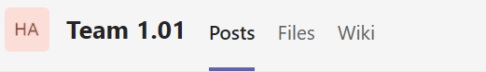
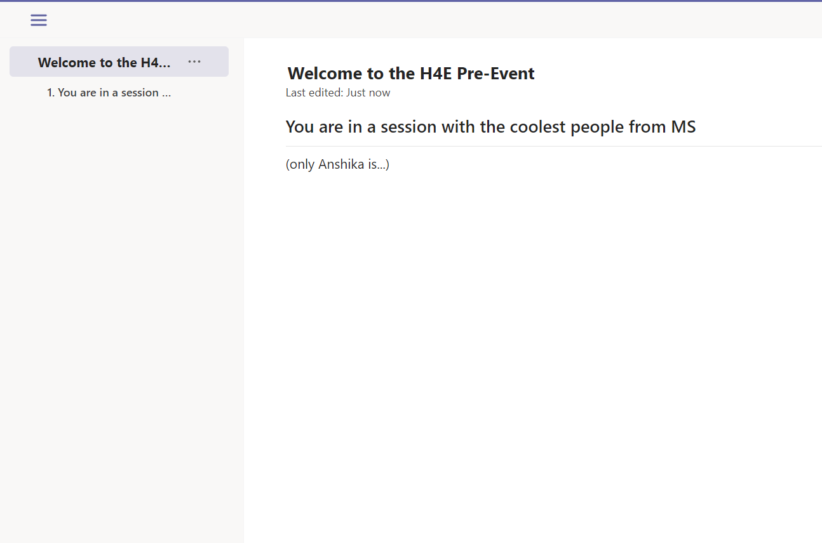
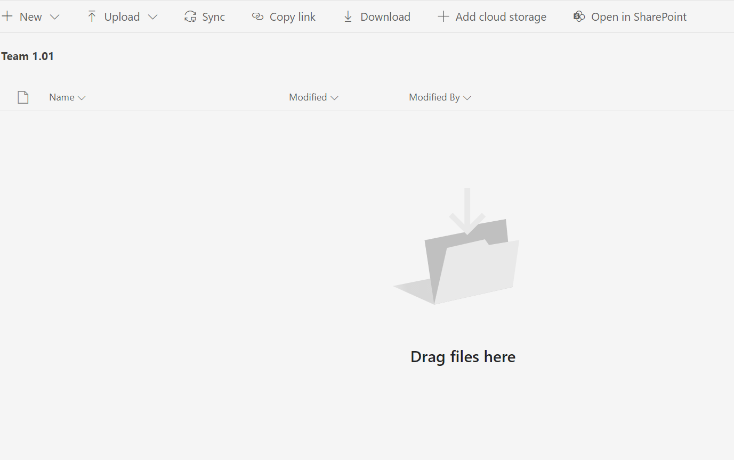
TABS

Slide 11
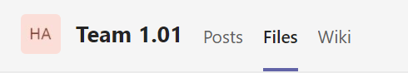
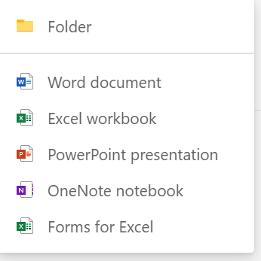
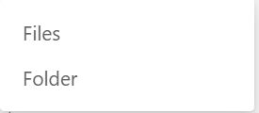
UPLOAD FILES

Slide 12
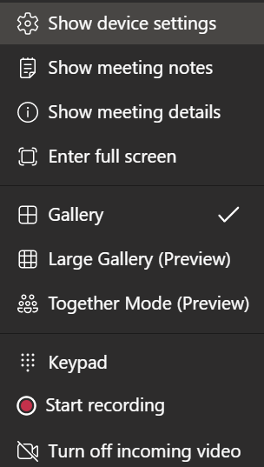

RECORD YOUR MEETING

Slide 13


Slide 14
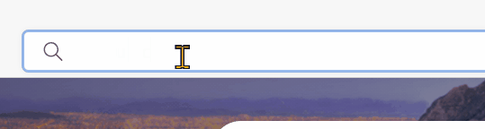
What is GitHub?
Sign up at:
It’s an online “code storage”
It can keep track of changes in files so you can revert back to a previously committed (saved) file
Pass along your ids to the organizers

Slide 15
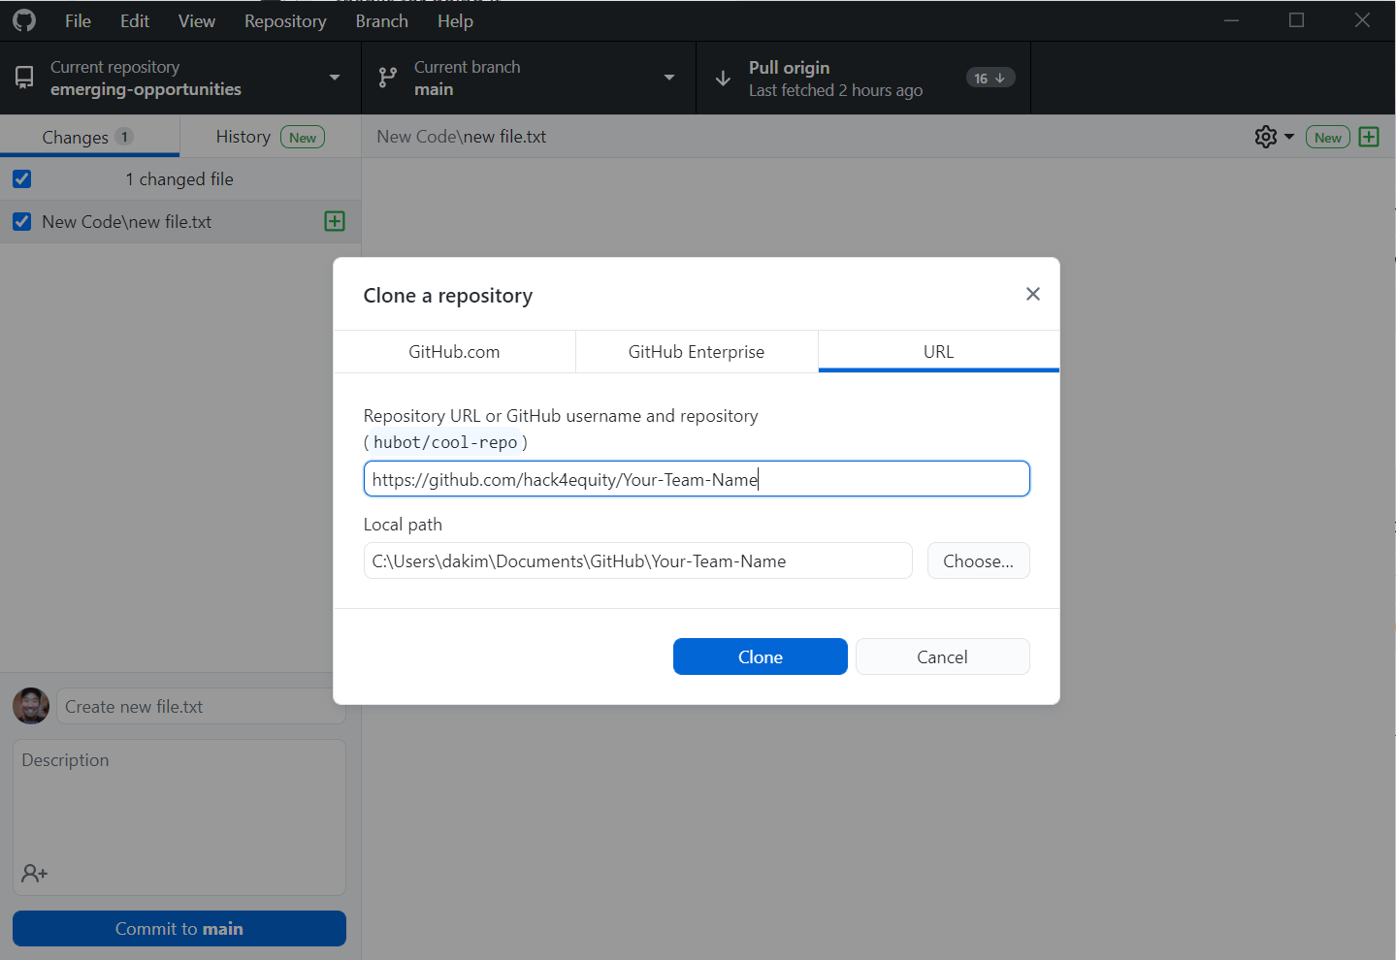
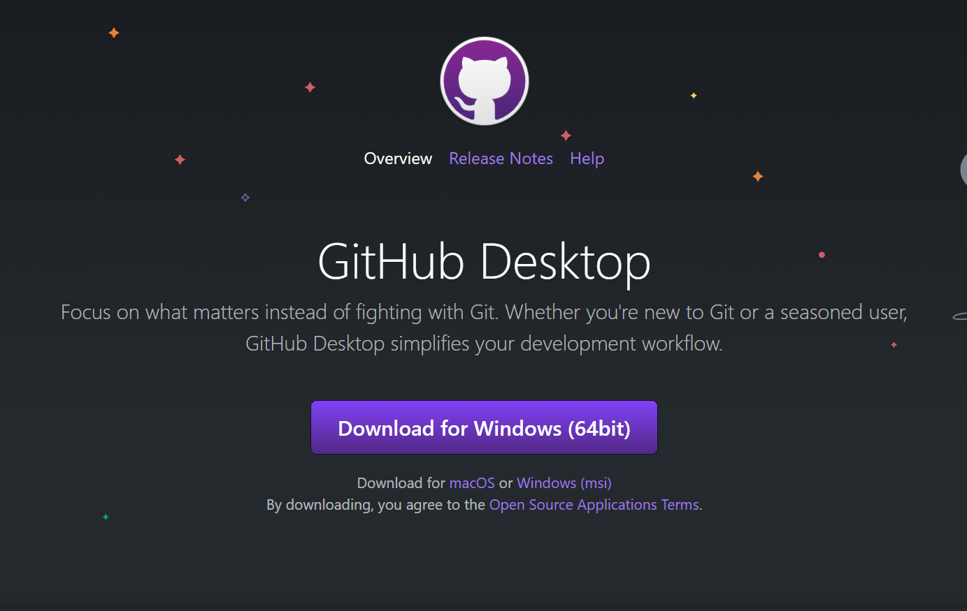
Go to: https://desktop.github.com/
Clone Repo: https://github.com/hack4equity/Your-Team-Name

Slide 16
DEMO

Slide 17


LAB ENVIRONMENT

Slide 18
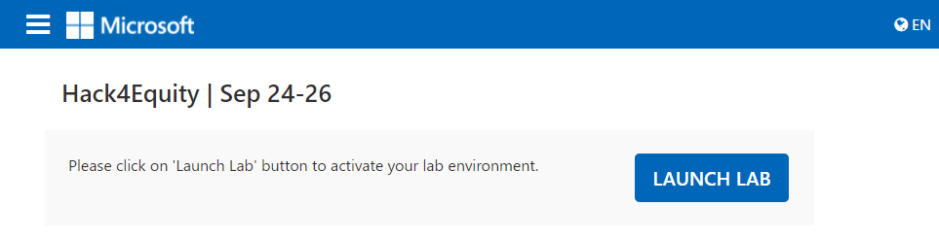
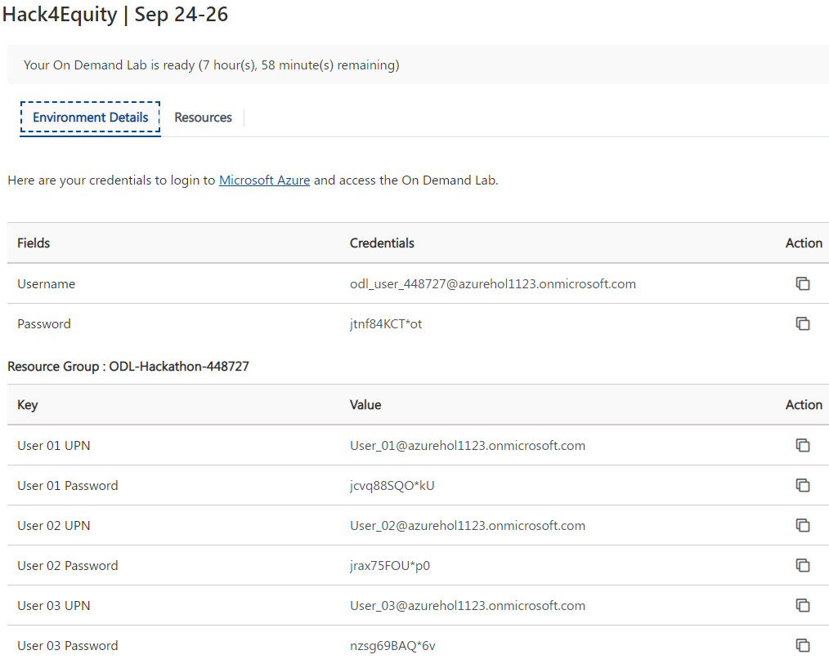

Slide 19
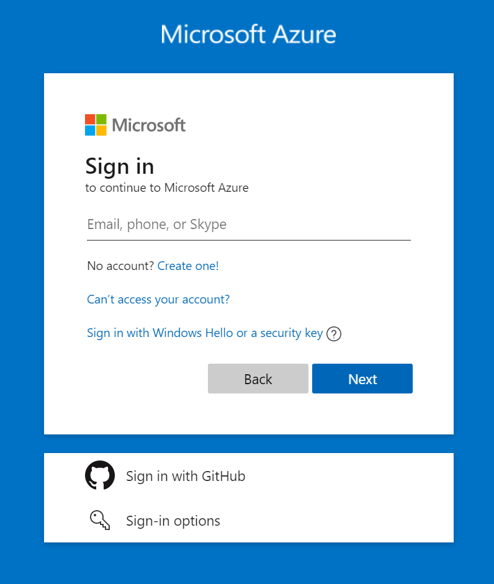
Go to: portal.azure.com
Username / UPN & Password
Provided by the Lab Environment

Slide 20
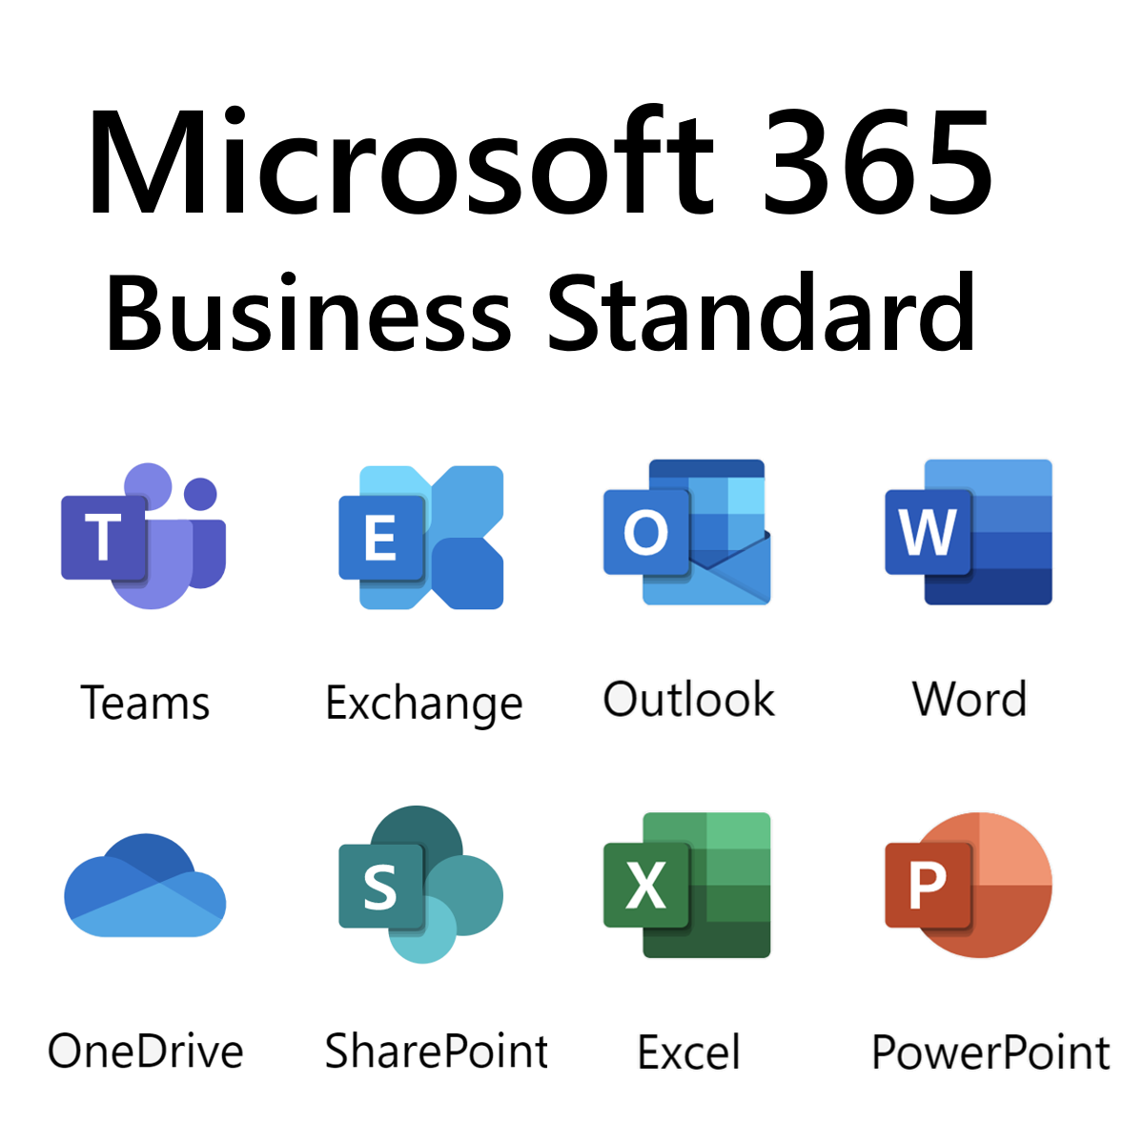
go to: office.com

Slide 21
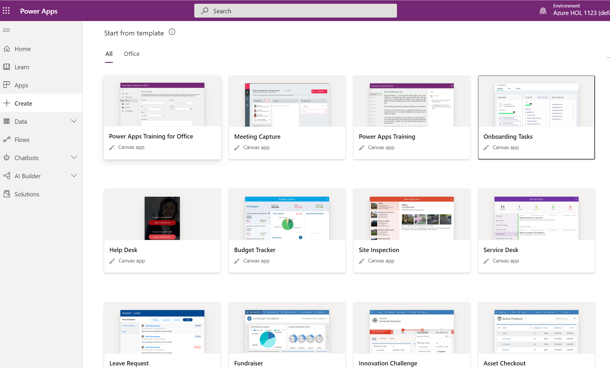
Go to: apps.powerapps.com

Slide 22
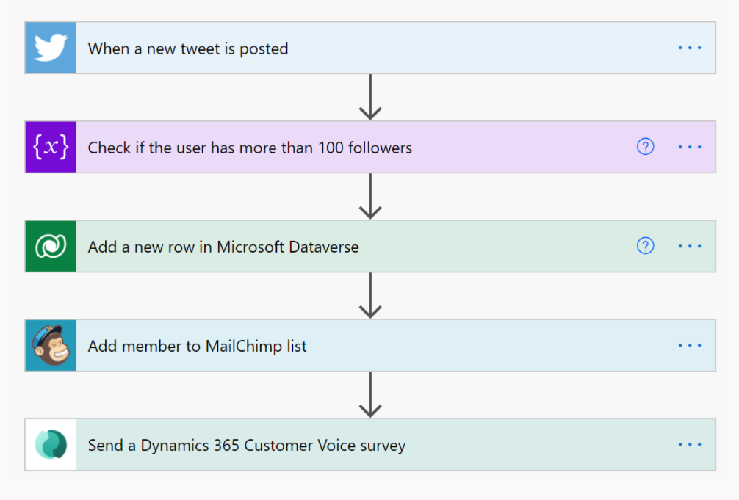
Go to:
flow.microsoft.com

Slide 23
DEMO

